Slide 1
Limited Use Disclaimer to Presenters
This sales presentation is appropriate only for use by producers that are also registered to offer investment advice and/or that possess specific qualifications or designations. Discussion of securities and securities transactions by those lacking the appropriate registration places their insurance license at risk.
When strategically partnering with or incorporating into your practice other professional services, such as tax or legal, clients must fully understand who provides which services; producers cannot hold themselves out as being able to provide services they are not qualified to perform.
Prior to use, investment advisors are strongly encouraged to obtain pre-approval from the broker-dealer or registered investment advisor with which they may be affiliated.
Producers are ultimately responsible for the use or implementation of this program material.

Slide 2
Your Retirement and Taxes
©2020 Emerging Advisor, LLC
Investment Advisory Services offered through Elevated Capital Advisors, LLC. An SEC Registered Investment Advisor.

Slide 3
Disclaimer
This material is provided courtesy of [agent/agency] and contains general information to help you understand basic financial planning strategies.
Throughout the presentation, we may generally discuss different financial vehicles; however, nothing I say should be construed as a recommendation to buy or sell any financial vehicle, nor should it be used to make decisions today about your investments.
My goal with this presentation is to expose you to ideas and financial vehicles that may help you work towards your financial goals. Please understand that I cannot make any promises or guarantees that you will accomplish such goals. All investments are subject to risk including the potential loss of principal.
This presentation is designed to provide general information on the subjects covered. It is not, however, intended to provide specific legal or tax advice and cannot be used to avoid tax penalties or to promote, market, or recommend any tax plan or arrangement. Please note that [Firm Name] and its representatives do not give legal or tax advice. You are encouraged to consult your tax advisor or attorney.
Investment Advisory Services offered through Elevated Capital Advisors, LLC. An SEC Registered Investment Advisor.
Despite efforts to be accurate and current, this presentation may contain out-of-date information; we are under no obligation to advise you of any subsequent changes related to the topics discussed in this presentation.
At the end of the seminar, you will be provided an opportunity to visit with us one-on-one to discuss your specific circumstance in a private, comfortable setting. There is no obligation to you for this visit. At this visit you may be provided with information regarding the purchase of insurance or investment products, or establishing an advisory relationship.
Notes:
Read disclosures
NEXT SLIDE

Slide 4
Income Plan
Note: Consult your tax advisor pertaining to your specific situation
Legacy And Estate Plan
Investment Plan
COMPLETE PLANNING
Healthcare Plan
Tax Plan

Slide 5
Quiz Questions
What color is a STOP sign?
Notes:
What color is a Stop sign?

Slide 7
Quiz Questions
What color is a YIELD sign?
Notes:
What color is a Yield sign?

Slide 10
Were YIELD signs ever yellow?
Yes. In fact, yellow was the standard color for YIELD signs for nearly 40 years.
The YIELD sign was added to the Manual on Uniform Traffic Control Devices in 1954.
In 1971, the YIELD sign was changed to use the red background you see today, along with the white region in the center of the sign.
Notes:
Were YIELD signs ever yellow?
Yes - in fact, yellow was the standard color for YIELD signs for nearly 40 years.
The YIELD sign was added to the Manual on Uniform Traffic Control Devices in 1954. In 1971, the YIELD sign was changed to use the red background you see today, along with the white region in the center of the sign

Slide 11
Myths and Misconceptions From the “Old World” can cause harm to you in the “New World.”
Notes:
Let’s start off with “Myths and Misconceptions from the “Old World” can cause harm to you in the “New World”. Let’s take a look at a couple of examples.

Slide 12
Taxation of Investment/ Interest Income

Slide 13
Tax Planning: The Four Buckets
INCOME AND ESTATE TAX-FREE
TAXABLE
TAX-DEFERRED
TAX-FREE
The more you have, the more you want to move assets to the right.
Notes:
Here’s how you do tax planning. It's all about these four buckets. By the way, if you don't like taxes, this is one thing you want to write down.
Here's the first one: the taxable bucket. In the accounts that go in here, money that you have in the taxable bucket are those dollars that you receive a 1099 on every year whether or not you spend the money.
So an example. How many of you have ever owned a CD? All right, you have a CD at the bank, and you earn interest on CDs. And each year, what does a bank send you? A 1099.
This is our taxable bucket. Things like bank accounts, brokerage accounts, trust accounts fall in this bucket.
The second bucket is the tax-deferred bucket. These are those investments and insurance products where the money grows without tax until the money is withdrawn. When the money comes out, that's when you pay tax. There are three primary financial products that fall in that bucket. First, employer sponsored retirement plans, right? 401(k)s, 403(b)s, and those IRAs, they fall in that bucket. Second, nonqualified annuities are a biggie. They fall in that bucket. Fixed or variable. Third, savings bonds fall in that bucket.
Third bucket is our tax-free bucket. Now, this is the fun one. There are only three financial vehicles that are tax free. Really two and a half, but only three. What are they? Roth IRA.
Municipal bonds. They're the half. The reason I say they're half is because, yes, the interest is tax free, but guess what? The interest counts against you for Social Security. So people who would otherwise not pay full tax on their Social Security, the interest on the municipal bond may force them to pay tax on Social Security. So I'll give that a half, but let's just give it, say, muni. What's third? This is the one that people get half the time, and half the time they don't. What do corporations use all the time to invest tax free?
Properly designed life insurance (very similar to Roth).
Now, all of these buckets fall within your taxable estate. And then you have this bucket way out here called our income tax-free, estate tax-free – this is where you have, ILITs, life insurance trusts, charitable trusts, all these special, fancy trust planning that you see. That's for people with, $11.58 million and above.

Slide 14
Social Security And Provisional Income

Slide 15
What is Provisional Income?
Provisional Income is the income the IRS tracks to determine if your Social Security will be taxed.
Source: https://www.irs.gov/publications/p590b/ch02.html; accessed Jan 2020
Notes:
Social Security benefits were initially exempt from federal income tax, but in 1983, they became partially taxable. In 1993, a second income threshold was added that increased the share of benefits subject to taxation. Today, some recipients of Social Security can collect all of their benefits tax-free. Others, however, are required to pay taxes on their Social Security benefits, and this is where provisional income comes into play.
Provisional income is a measure used by the IRS to determine whether or not recipients of Social Security are required to pay taxes on their benefits. Provisional income is calculated by adding up a recipient's gross income, tax-free interest, and 50% of Social Security benefits.
NEXT SLIDE

Slide 16
Provisional Income Thresholds
Combined income limitations for taxation of Social Security retirement benefits
Percentage of benefits that are taxable | Single, head of household and qualifying widower | Married filing jointly
0% | Below $25,000 | Below $32,000
Up to 50% | $25,000 - $34,000 | $32,000 - $44,000
Up to 85% | Above $34,000 | Above $44,000
Source: https://www.ssa.gov/planners/taxes.html; accessed Jan 2020
Notes:
This slide shows the taxation of SS benefits.

Slide 17
What Counts as Provisional Income
ALL Earned Income | 1099s from taxable bucket
Distributions from Qualified Plans (IRAs, 401(k)s, etc.) | Required Minimum Distributions (RMDs)
Pensions | Interest from Municipal Bonds
Rental income | One-half of your Social Security
Notes:
So, what income does the IRS keep track of to determine if your Social Security gets taxed? The following is a list of the most common sources of provisional income.
The IRS adds up all your provisional income and, based on that total, and your marital status, determines what percentage of your Social Security benefits will become taxed. That percentage of your Social Security is then taxed at your highest marginal tax rate.

Slide 18
Example of Social Security Taxation
Sample Data
Gross Income | Social Security Income | Tax Exempt Interest
$32,184 | $40,596 | $0
Social Security Provisional Income
Gross Income | 50% Social Security Benefits | Tax Exempt Interest | Provisional Income | 0% Taxable $0-$32,000 | 50% Taxable $32,001-$44,000 | 85% Taxable $44,0001+ | Taxable Social Security | Max Taxable Social Security
$32,184 | $20,298 | $0 | $52,482 | $32,000 | $12,000 | $8482 | $13,210 | $34,507
*This information provided by these projections and calculators is for illustrative purposes only.
Notes:
How provisional income affects taxation Your provisional income and your tax filing status decide whether, and how much, your Social Security benefits are taxed:
Let’s look at an example. Let's say your gross income is $32,184 and you earned $0 in municipal bond interest. Add those amounts together to arrive at $32,184. Now let's assume you receive $40,596 in Social Security benefits. Divide that in half to arrive at $20,298. Add $32,184 and $20,298 and your provisional income is $52,482.

Slide 19
Withdrawal Strategy
Does it matter?

Slide 20
How wise is Conventional Wisdom?
Turns out, it’s not always good advice.
Conventional wisdom says to convert portfolio
Taxable Accounts
Tax Deferred Accounts
Tax Exempt Accounts (Roth)
Non-Deductible IRA
Non-Qualified Annuity
Notes:
How wise is Conventional Wisdom? Turns out, it’s not always good advice.
Conventional wisdom says to convert portfolio assets to retirement income in this order:
Taxable Accounts
Tax Deferred Accounts
Tax Exempt Accounts (Roth)
Non-Deductible IRA
Non-Qualified Annuity

Slide 21
Conventional Wisdom of Retirement Liquidations
Let the IRA Compound!
The classic approach:
after-tax “taxable” brokerage accounts should be liquidated first, while retirement accounts like IRAs and 401(k) plans receive preferential (tax-deferred) treatment and should be liquidated last.

Slide 22
Case Study
But is that really the best strategy for you?
Jim(66) and Joan(65) have saved a total of $679,000:
401(k) $500,000
Taxable $125,000
Roth $ 54,000
Plan to retire at age 67
They know they will need to spend conservatively, but they plan to enjoy retirement. Because they have multiple accounts that are taxed differently, they need advice on a withdrawal strategy to make their savings last as long as possible.
This hypothetical example is for illustrative purposes only, and should not be deemed a representation of past or future results, and is no guarantee of return or future performance.

Slide 23
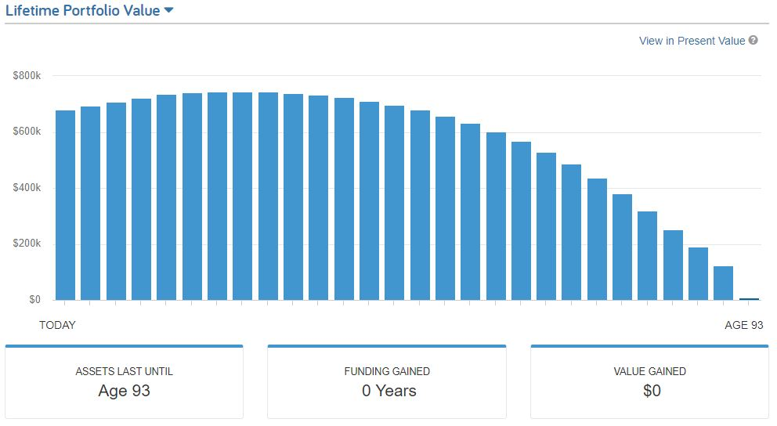
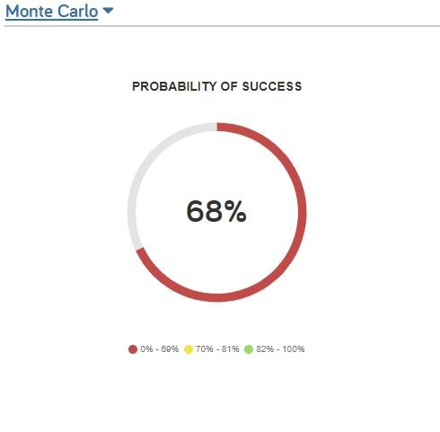
Scenario A
Conventional Wisdom
This hypothetical example is for illustrative purposes only, should not be deemed a representation of past or future results and is no guarantee of return or future performance. This example does not represent any specific product or service.
Notes:
What we've done here is we've used our Emoney software to determine how Jim and Joan will fair in retirement using conventional wisdom. Now, with conventional wisdom, they only have their needs and wants covered until age 93 and 92. That means they're going to run out of money before they run out of retirement. It will be only a few years before their only source of income is social security. In this example, we used an inflation rate of 3%, an annual rate of return of 6% and a withdrawal rate of a net of $30,000 per year.

Slide 24
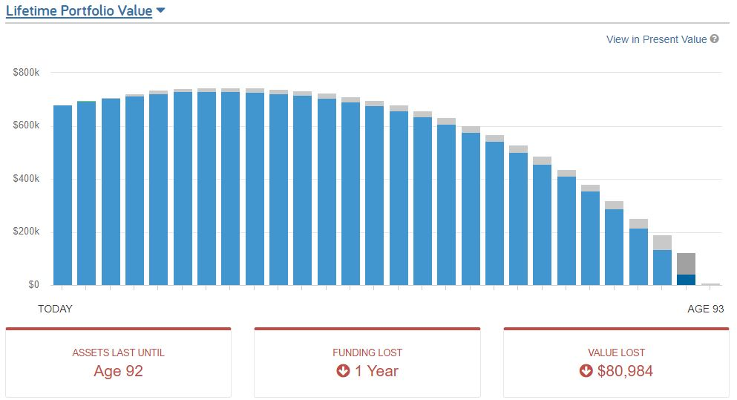
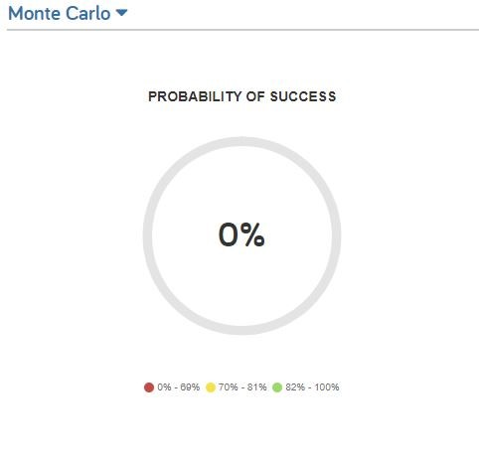
Scenario B
Unconventional Wisdom
This hypothetical example is for illustrative purposes only, should not be deemed a representation of past or future results and is no guarantee of return or future performance. This example does not represent any specific product or service.
Notes:
In this example, the unconventional wisdom, what we did is we flipped the returns, so instead of using the taxable accounts first, tax deferred accounts, and then Roth accounts, we went ahead and we did a spend down with using the Roth account first, the tax deferred account second, and then the taxable accounts third, so here's the difference for Jim and Joan - their level of coverage in the amount of their lifetime needs and wants that their assets will cover is now a little bit shorter. There still is a small gap between their assets and needs, simply changing the order they withdraw from their accounts, means that they have 1 less year of portfolio longevity. Now, in the conventional wisdom and unconventional wisdom, these previous two strategies, this is what we call sequential withdrawals.
In this example we kept everything the same, we used an inflation rate of 3.%, an annual rate of return of 6% and a withdrawal rate of a net of $30,000 per year.

Slide 25
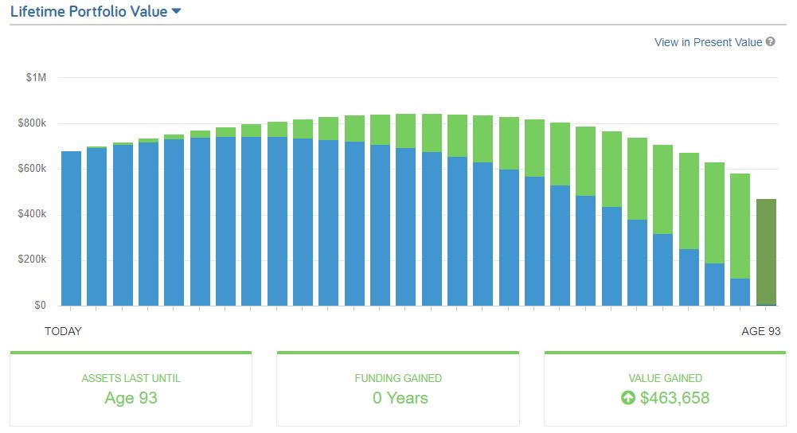
Scenario C
Multiple Accounts
This hypothetical example is for illustrative purposes only, should not be deemed a representation of past or future results and is no guarantee of return or future performance. This example does not represent any specific product or service.
Notes:
In this example, the unconventional wisdom, what we did is we used all accounts simultaneously rather than sequentially. Here's the difference for Jim and Joan - their level of coverage in the amount of their lifetime needs and wants that their assets will cover is now a little bit longer - it's age 101 to 100. There still is a small gap between their assets and needs, simply changing the how they withdraw from their accounts, means that they have 5 more years of portfolio longevity.
In this example we kept everything the same, we used an inflation rate of 3.%, an annual rate of return of 6% and a withdrawal rate of a net of $30,000 per year.

Slide 26
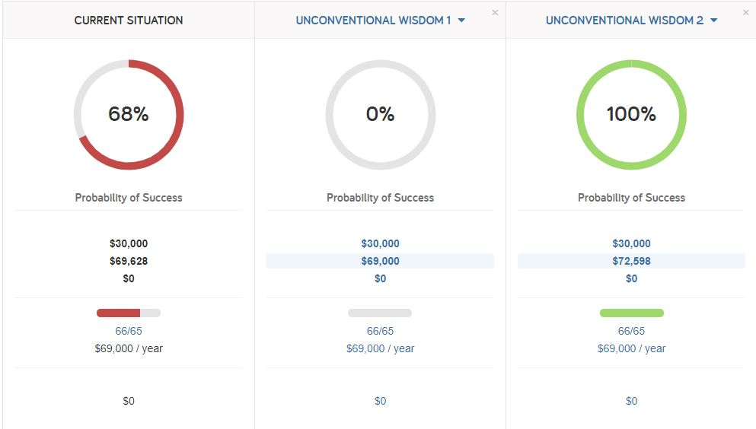
Scenario Comparison
This hypothetical example is for illustrative purposes only, should not be deemed a representation of past or future results and is no guarantee of return or future performance. This example does not represent any specific product and/or service.
Notes:
Lastly, let's look at a scenario comparison. Using sequential withdrawals, scenario A, is pulling from your taxable accounts and your tax-deferred and your tax-free accounts. Based on the results of our software and the assumptions used, the redline age that you run out of money is 93 and 92 and they're able to pull a total income of $1.1 million. Unconventional wisdom, when it comes to withdrawing your income, means that you're going to pull from your Roth first, your tax-deferred second, and your taxable accounts third. The redline age here is 96 or 95, and they have a total income of $1.6 million, but if you look at simultaneous withdrawals, scenario C, the redline age is now age 101 or 100 and they're able to pull out $2.1 million in withdrawals from the accounts. The key here is the withdrawal strategy that's created by simultaneously pulling income from various accounts to create the most efficient withdrawal strategy. From a tax perspective it is increasingly important the closer that you get to retirement to have a withdrawal strategy and a tax plan.

Slide 27
Income Plan
Legacy And Estate Plan
Investment Plan
Summary - Complete Planning
COMPLETE PLANNING
Healthcare Plan
Tax Plan
Notes:
SO what does all this mean for you?
First, we hope you understand better that when you claim SS matters! Sometimes it can be a matter of a month of waiting that will make a substantial difference in the lifetime benefits you receive.
The rules are complicated. They are voluminous. While you may be able to do some internet research and learn a few of the rules, the likelihood that you will overlook something important is significant. You need help with the rules, and we can provide that assistance.
There are many combinations of those rules that may help you. We use powerful software coded with all the rules to help you select a strategy that will get you the most in benefits – and we can help you compare other claiming options side-by-side.
Because your decision is irrevocable beyond 12 months, it’s critical that you get it right. You can’t afford to make a mistake.
Don’t delay – see us immediately
You need expert advice. Our firm can help remove the complexity and make it simpler for you.

Slide 28
Notes:
Insert your FORM here

