Slide 1
Limited Use Disclaimer to Presenters
This sales presentation is appropriate only for use by producers that are also registered to offer investment advice and/or that possess specific qualifications or designations. Discussion of securities and securities transactions by those lacking the appropriate registration places their insurance license at risk.
When strategically partnering with or incorporating into your practice other professional services, such as tax or legal, clients must fully understand who provides which services; producers cannot hold themselves out as being able to provide services they are not qualified to perform.
Prior to use, investment advisors are strongly encouraged to obtain pre-approval from the broker-dealer or registered investment advisor with which they may be affiliated.
Producers are ultimately responsible for the use or implementation of this program material.

Slide 2
Your Retirement and Taxes
©2020 Emerging Advisor, LLC
Investment Advisory Services offered through Elevated Capital Advisors, LLC. An SEC Registered Investment Advisor.

Slide 3
Disclaimer
This material is provided courtesy of [agent/agency] and contains general information to help you understand basic financial planning strategies.
Throughout the presentation, we may generally discuss different financial vehicles; however, nothing I say should be construed as a recommendation to buy or sell any financial vehicle, nor should it be used to make decisions today about your investments.
My goal with this presentation is to expose you to ideas and financial vehicles that may help you work towards your financial goals. Please understand that I cannot make any promises or guarantees that you will accomplish such goals. All investments are subject to risk including the potential loss of principal.
This presentation is designed to provide general information on the subjects covered. It is not, however, intended to provide specific legal or tax advice and cannot be used to avoid tax penalties or to promote, market, or recommend any tax plan or arrangement. Please note that [Firm Name] and its representatives do not give legal or tax advice. You are encouraged to consult your tax advisor or attorney.
[Investment Advisory Disclosure]
Despite efforts to be accurate and current, this presentation may contain out-of-date information; we are under no obligation to advise you of any subsequent changes related to the topics discussed in this presentation.
At the end of the seminar, you will be provided an opportunity to visit with us one-on-one to discuss your specific circumstance in a private, comfortable setting. There is no obligation to you for this visit. At this visit you may be provided with information regarding the purchase of insurance or investment products, or establishing an advisory relationship.
Notes:
Read disclosures
NEXT SLIDE

Slide 4
Income Plan
Note: Consult your tax advisor pertaining to your specific situation
Legacy And Estate Plan
Investment Plan
COMPLETE PLANNING
Healthcare Plan
Tax Plan

Slide 5
Quiz Questions
What color is a STOP sign?
Notes:
What color is a Stop sign?

Slide 7
Quiz Questions
What color is a YIELD sign?
Notes:
What color is a Yield sign?

Slide 10
Were YIELD signs ever yellow?
Yes. In fact, yellow was the standard color for YIELD signs for nearly 40 years.
The YIELD sign was added to the Manual on Uniform Traffic Control Devices in 1954.
In 1971, the YIELD sign was changed to use the red background you see today, along with the white region in the center of the sign.
Notes:
Were YIELD signs ever yellow?
Yes - in fact, yellow was the standard color for YIELD signs for nearly 40 years.
The YIELD sign was added to the Manual on Uniform Traffic Control Devices in 1954. In 1971, the YIELD sign was changed to use the red background you see today, along with the white region in the center of the sign

Slide 11
Myths and Misconceptions From the “Old World” can cause harm to you in the “New World.”
Notes:
Let’s start off with “Myths and Misconceptions from the “Old World” can cause harm to you in the “New World”. Let’s take a look at a couple of examples.

Slide 12
A Brief History of Tax Rates
Top Federal Tax Bracket
Year 1913 | 7%
Year 1918 | 77%
Year 1944 | 94%
Year 1968 | 75%
Year 1971 | 70%
Year 2000 | 39.6%
Year 2010 | 35%
Year 2019 | 37%
**Source IRS
Source: http://taxfoundation.org/article/2020-tax-brackets; accessed Jan 2020
Notes:
--------------------------------------------
Before I show you the history of tax rates in our country, does any one want to take a stab at the highest marginal tax bracket in the history of our country? What’s the worst it’s ever been? (Wait for responses-then show slide). You may find this hard to believe, but the last 2 years of WWII, the highest marginal tax bracket was 94%. Throughout much of the 60s, it was between 70 and 90%. You don’t have to go very far back into the history of our country to find tax rates that were easily double what they are today. Why do you think I’m showing you this slide?
This slide shows the history of the top federal tax bracket. Starting in 1913 when the top rate was 7% and all the way to 2010 when the top rate was 35%. The current federal top tax rate is 37% with an additional 3.8% Medicare tax from the Patient Protection and Affordable Care of 2010 if your modified adjusted gross income (MAGI) exceeds the threshold amounts (of $200,000 single, $250,000, married filing jointly).
The 3.8% Medicare tax is imposed on the lesser of:
Net investment income
OR
The amount of modified adjusted gross income over the threshold amount.
Consult your tax advisor pertaining to your specific situation.
NEXT SLIDE

Slide 13
2020 Federal Income Tax Tables
Filing Status | Taxable Income | Marginal Tax Bracket
Single | Up to $9,875 | 10%
 | $9,876 but not over $40,125 | 12%
 | $40,126 but not over $85,525 | 22%
 | $85,526 but not over $163,300 | 24%
 | $163,301 but not over $207,350 | 32%
 | $207,351 but not over $518,400 | 35%
 | Over $518,401 | 37%
Source:
http://taxfoundation.org/article/2020-tax-brackets; accessed Jan 2020
Notes:
Here is a look at the 2020 tax tables.
Single filing status:
Taxable Income Under $9,875 the marginal tax rate is 10%
$9,876 but not over $40,125 the marginal tax rate is 12%
$40,126 but not over $85,525 the marginal tax rate is 22%
$85,526 but not over $163,300 the marginal tax rate is 24%
$163,301 but not over $207,350 the marginal tax rate is 32%
$207,351 but not over $518,400 the marginal tax rate is 35%
Over $518,401 the marginal tax rate is 37%
And remember this is just federal taxes, you may also have Social Security, Medicare, state and local taxes.
NEXT SLIDE

Slide 14
2020 Federal Income Tax Tables
Filing Status | Taxable Income | Marginal Tax Bracket
Married Filing Jointly | Up to $19,750 | 10%
 | $19,751 but not over $80,250 | 12%
 | $80,251 but not over $171,050 | 22%
 | $171,051 but not over $326,600 | 24%
 | $326,601 but not over $414,700 | 32%
 | $414,701 but not over $622,050 | 35%
 | Over $622,051 | 37%
Source:
http://taxfoundation.org/article/2020-tax-brackets; accessed Jan 2020
Notes:
Married filing jointly.
Not over $19,750 marginal tax rate is 10%
$19,751 but not over $80,250 the marginal tax rate is 12%
$80,251 but not over $171,050 the marginal tax rate is 22%
$171,051 but not over $326,600 the marginal tax rate is 24%
$326,601 but not over $414,700 the marginal tax rate is 32%
$414,701 but not over $622,050 the marginal tax rate is 35%
Over $622,051 the marginal tax rate is 37%
NEXT SLIDE

Slide 15
2020 Federal Income Tax Tables
Marginal Tax Rate Example:
Married filing joint with $120,000 per year in taxable income
Taxable Income | Marginal Tax Rate and Amount
$0-$19,750 | 10% or $1,975
$19,751-$80,250 | 12% or $7,260
$80,251-$120,000 | 22% or $8,745
Total tax paid= $17,980 or Net Tax Rate of 14.9%
This hypothetical example is for illustrative purposes only, should not be deemed a representation of past or future results and is no guarantee of return or future performance. This example does not represent any specific product and/or service.
Source:
Source: http://taxfoundation.org/article/2020-tax-brackets; accessed Jan 2020
Notes:
Your marginal tax rate is the amount of tax paid on an additional dollar of income. The marginal tax rate for an individual will increase as income rises. As income increases, what is earned will be taxed at a higher rate than your first dollar earned. While many believe this is the most equitable method of taxation, many others believe this discourages business investment by removing the incentive to work harder.
Let’s look at an example. Let’s use a married couple with an income of $120,000 per year
Income from $0-$19,750 is taxed at 10% or $1,975
Income from $19,751-$80,250 is taxed at 12% or $7,260
Income from $80,251-$120,000 is taxed at 22% or $8,745
The total tax paid in this example is $17,980 or they have a Net Tax Rate of 14.9%
NEXT SLIDE

Slide 17
2019 SECURE Act
The Setting Every Community Up for Retirement Enhancement Act, or the SECURE Act, was passed by Congress in December 2019.
This legislation is effective as of January 1, 2020. The law does the following:

Slide 18
2019 SECURE Act
Top 3 items to know for individuals:
1. Allow taxpayers of any age to make traditional IRA contributions – Prior to the SECURE Act’s passage, taxpayers that had reached age 70 ½ were not eligible to make those contributions.
2. Increase the age at which Required Minimum Distributions (RMDs) begin – Currently, it is age 70 ½. The new law makes it age 72. However, those that turned 70 ½ in 2019 or earlier are still required to take RMDs according to the old rules.
3. Eliminate the “Stretch-IRA” with life expectancy payments for most beneciaries of IRAs and Qualified retirement plans, and subject those beneciaries to a new “10-year rule” –
Only
1) surviving spouses
2) disabled or chronically ill individuals,
3) beneciaries that are not more than 10 years younger than the decedent, and
4) minor children would still be able to use life expectancy payments. All other beneciaries would need to
distribute the full account balances by the end of the tenth year following the year of death.
Notes:
1. You can Now Contribute to Traditional IRA Accounts After Age 70.5
Prior to the SECURE Act’s passage, taxpayers that had reached age 70 ½ were not allowed to make contributions to traditional IRA accounts, even if they were still employed. Removing the age limit is a huge success for Americans. It’s necessary too, as life expectancies continue to rise, and people continue to work into their later years in order to fund their retirement.
With the SECURE Act passing, the traditional IRA rules will match current 401(k) regulations and Roth IRAs - allowing any American, regardless of age, to continue contributing as long as he or she is employed.
2. Required Minimum Distributions Starting Age is Now 72
Following the same principles behind the age limit removal of contributions to Traditional IRAs, the SECURE Act will raise the age for required minimum distributions from 70 ½ to 72. However, those that turned 70 ½ in 2019 or earlier are still required to take RMDs according to the old rules.
With life expectancies rising, more and more retirees are running out of money quicker. Pushing back RMDs another 1.5 years will give a nice boost to Americans who are trying to get their money to last a little bit longer, especially with many choosing to continue working in their 70s.
Delaying the age of RMDs also is beneficial since it delays the added tax burden that withdrawals add. RMDs can potentially bring retirees’ income level up a tax bracket, so delaying the tax gives them more time to save for the future.
3. The Stretch IRA Strategy is Coming to an End
One of the most popular retirement strategies to stretch out the tax advantages of individual retirement accounts for future generations came to an end.
Prior to the SECURE Act, an inherited IRA may be “stretched out” by taking only the required minimum distributions each year instead of getting a lump sum. Under the old rules, these “stretch IRAs” allowed beneficiaries to stretch out the distributions, and the tax result, over their life expectancy. However, this strategy isn’t possible under the new Setting Every Community Up for Retirement Enhancement Act.
Basically, this means that if you become a beneficiary of an IRA, you’re going to get taxed quicker and at much higher rates. Most non-spousal beneficiaries are required to liquidate their inherited accounts by the end of the tenth year.
Many financial planners consider this to be the most controversial rule within the SECURE Act, as it will force many American retirees to rethink their current retirement strategy and estate plans.

Slide 19
2019 SECURE Act
Top 3 items to know for businesses:
1. Increase access to Multiple Employer Plans (MEPs) for small businesses and improve the quality of MEP service providers – MEPs make the startup and administrative costs for retirement plans much more affordable for small employers and reduce investment costs for participants.
2. Change the maximum service requirement restriction employers can place on employees to participate in 401(k) and profit-sharing plans – Currently the maximum restriction is at least one year with at least 1,000 hours. The new law would allow all employees with three consecutive years with at least 500 hours in each to participate as well.
3. Move the deadline for establishing qualified plans that are solely employer-funded (such as profit-sharing plans) to the tax filing deadline plus extensions - Currently, those types of plans need to be established by December 31st of a tax year, in order to make contributions for that tax year. The new law would make the deadline the same as is currently in place for SEP IRA plans.
Notes:
1. More Small Employers Likely to Offer Workplace Retirement Plans
According to Pew Charitable Trusts, approximately 30% of Americans do not have access to a workplace retirement plan. The SECURE Act attempts to address this problem by making it simpler and more attractive for small employers to offer this benefit.
According to Barron’s:
“The bill also increases a tax credit related to startup costs for setting up a retirement savings plan to $5,000 from $500, as well as offering a $500 credit for plans that set up automatic enrollment—both of which could offer an additional nudge to employers.
2. Change the maximum service requirement restriction employers can place on employees to participate in 401(k) and profit-sharing plans – Currently the maximum restriction is at least one year with at least 1,000 hours. The new law would allow all employees with three consecutive years with at least 500 hours in each to participate as well.
3. Move the deadline for establishing qualified plans that are solely employer-funded (such as profit-sharing plans) to the tax filing deadline plus extensions - Currently, those types of plans need to be established by December 31st of a tax year, in order to make contributions for that tax year. The new law would make the deadline the same as is currently in place for SEP IRA plans.

Slide 20
2019 SECURE Act
SECURE Act Summary
In summary, the SECURE Act is likely to increase retirement savings in America, provide new opportunities to save on taxes beyond age 70.5 and – unfortunately – take away from the “stretch IRA” estate planning strategy.
These changes present the opportunity for new planning strategies in 2020 and beyond, especially when it comes to tax minimization, legacy assurance and maximizing inheritances.

Slide 21
Taxation of Investment/ Interest Income

Slide 22
Tax Planning: The Four Buckets
INCOME AND ESTATE TAX-FREE
TAXABLE
TAX-DEFERRED
TAX-FREE
The more you have, the more you want to move assets to the right.
Notes:
Here’s how you do tax planning. It's all about these four buckets. By the way, if you don't like taxes, this is one thing you want to write down.
Here's the first one: the taxable bucket. In the accounts that go in here, money that you have in the taxable bucket are those dollars that you receive a 1099 on every year whether or not you spend the money.
So an example. How many of you have ever owned a CD? All right, you have a CD at the bank, and you earn interest on CDs. And each year, what does a bank send you? A 1099.
This is our taxable bucket. Things like bank accounts, brokerage accounts, trust accounts fall in this bucket.
The second bucket is the tax-deferred bucket. These are those investments and insurance products where the money grows without tax until the money is withdrawn. When the money comes out, that's when you pay tax. There are three primary financial products that fall in that bucket. First, employer sponsored retirement plans, right? 401(k)s, 403(b)s, and those IRAs, they fall in that bucket. Second, nonqualified annuities are a biggie. They fall in that bucket. Fixed or variable. Third, savings bonds fall in that bucket.
Third bucket is our tax-free bucket. Now, this is the fun one. There are only three financial vehicles that are tax free. Really two and a half, but only three. What are they? Roth IRA.
Municipal bonds. They're the half. The reason I say they're half is because, yes, the interest is tax free, but guess what? The interest counts against you for Social Security. So people who would otherwise not pay full tax on their Social Security, the interest on the municipal bond may force them to pay tax on Social Security. So I'll give that a half, but let's just give it, say, muni. What's third? This is the one that people get half the time, and half the time they don't. What do corporations use all the time to invest tax free?
Properly designed life insurance (very similar to Roth).
Now, all of these buckets fall within your taxable estate. And then you have this bucket way out here called our income tax-free, estate tax-free – this is where you have, ILITs, life insurance trusts, charitable trusts, all these special, fancy trust planning that you see. That's for people with, $11.58 million and above.

Slide 23
Taxation of Investment/Interest Income
Interest Income
Ordinary Income Tax Rates* | Long-term Capital Gain & Qualified Dividend Tax Rates*
$0-80,000 | 0%
$80,001-$496,600 | 15%
$496,601 or more | 20%
Dividend Income
Capital Gains
* Based on Married Filing Jointly status
https://taxfoundation.org/2020-tax-brackets/#capgains
Notes:
When we look at income that is currently taxable there are three types of income.
Interest income that is taxed as ordinary income
Capital gains income
And dividend income
* Based on Married Filing Jointly status
NEXT SLIDE

Slide 24
Taxation of Investment/ Interest Income
Interest Income
Interest income is earned on deposits at banks and credit unions, on money market funds, on bonds, and on loans, such as seller-financed mortgages.
Becomes taxable when paid
Subject to ordinary income tax rates
Notes:
Interest Income
Interest income is earned on deposits at banks and credit unions, on money market funds, on bonds, and on loans, such as seller-financed mortgages. It will become taxable when paid. Subject to Ordinary income tax rates

Slide 25
Taxation of Investment/ Interest Income
Capital Gains
Profit realized from the sale of a non-inventory asset
Most common capital gains are realized from the sale of stocks, bonds, precious metals and property.
Short-term capital gains and long-term capital gains are taxed differently.
Consult your tax advisor pertaining to your specific situation.
Notes:
Capital Gains
Profit realized from the sale of a non inventory asset
Most common capital gains are realized from the sale of stocks, bonds, precious metals and property.
Short term capital gains and long term capital gains are taxed differently.
Note- Consult your tax advisor pertaining to your specific situation

Slide 26
Taxes on Investment Income
A dividend tax is an income tax on dividend payments to the shareholders (stockholders) of a company.
Ordinary Dividends are paid out of earnings and profits of a corporation and are seen as ordinary income.
Dividend Income
Qualified Dividends are ordinary dividends meeting special requirements and are taxed at a 0%, 15%, or 20% level depending on your level of income.
Notes:
Dividend Income-
A dividend tax is an income tax on dividend payments to the shareholders (stockholders) of a company.
Ordinary Dividends- are paid out of earnings and profits of a corporation. Seen as ordinary income
Qualified Dividends- are ordinary dividends meeting special requirements and are taxed at a 0%, 15%, or 20% level depending on your level of income
Read footnote: Qualified dividends are from domestic corporations and certain foreign corporations but don’t include dividends from certain preferred stock and most REITs. The current maximum tax rate on long-term capital gains (excluding recaptured Section 1250 gain and gain from sales of collectables and qualifying small business stock) is 20%.
NEXT SLIDE

Slide 27
Tax-Advantaged Accounts
Tax-Deferred
Investment/interest earnings accumulate without tax until owner withdraws and takes possession of them
Money withdrawn is usually taxed as Ordinary Income (and may be subject to early withdrawal penalties)
401(k), 403(b), 457 plans, IRAs, Deferred annuities
Consult your tax advisor pertaining to your specific situation.
Notes:
Tax Deferred
Investment/interest earnings accumulate tax free until owner withdraws and takes possession of them
Money withdrawn is usually taxed as ordinary income (may be subject to early withdrawal penalties)
401(k), 403(b), 457 plans, IRAs, Deferred annuities

Slide 28
Contribution Limits 2020
Retirement Plans |  | 2020
Traditional and Roth | Below Age 50 | $ 6,000
 | Catch-up Contribution: Age 50+ | $ 7,000
Simple IRA | Maximum Employee Contribution | $ 13,500
 | Catch-up Contribution: Age 50+ | $ 3,000
 | Maximum Employer Elective Deferral Match: dollar-for-dollar up to 3% of the employee's compensation | $ 13,500
 | Maximum Employer Non-Elective Contribution: 2% of each eligible employee's compensation | $ Varies
SEP IRA | Maximum Employer Contribution | $ 57,000
401(k), 403(b), and 457(b) | Maximum Employee Contribution | $ 19,500
 | Catch-up Contribution: Age 50+ | $ 6,500
 | Highly Compensated Employee | $ 130,000
Profit Sharing and 401(k) | Defined Contribution Limit | $ 57,000
 | Top-heavy Plan Key Employee Compensation | $ 185,000
Profit Sharing, 401(k), and SEP | Annual Compensation Limit | $ 285,000
* Only 457(b) plans of state and local governments may allow catch-up contributions for participants who are aged 50 or older. Some plans also allow Special 457(b) catch-up contributions. Refer to your plan details for further information
Source: https://www.irs.gov/retirement-plans/plan-participant-employee/retirement-topics-catch-up-contributions ; accessed Jan 2020

Slide 29
Required Minimum Distributions
Distributions begin on your Required Beginning Date (RBD)
RBD is the calendar year in which you reach age 72
(Unless you turned 70 ½ on or before 12/31/2019)
Every year your Required Minimum Distributions grow
Notes:
Here are some key dates and phrases for your planning. Distributions begin on your Required Beginning Date. Your Required Beginning Date is the April 1st of the year following the calendar year in which you reach age 72. However, this doesn’t apply to those who turned 70 ½ on or before 12/31/2019. For those individuals, The SECURE Act did not change the RBD.
The other thing I’d like to bring to your attention as it relates to your Required Minimum Distributions is this: every year the withdrawal percentage used to calculate your RMD gets bigger. This is the IRS’s way of making sure that you pay taxes on most of this money before you die. It’s their way of creating a predictable stream of tax revenue over the course of your retirement.
Starting in 2021, we could see a slight change to the RMD calculations. With new IRS tables coming out, the percentages of RMDs are likely to go down.

Slide 30
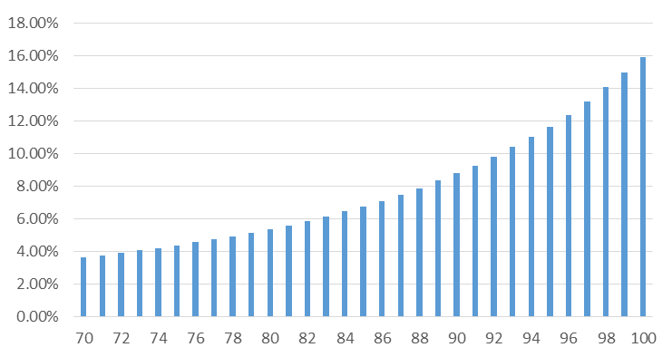
Required Minimum Distributions
Source: https://www.irs.gov/pub/irs-tege/uniform_rmd_wksht.pdf
Notes:
When you begin your RMDs at 72, it starts off at about 3.91% of your cumulative tax-deferred balances. Every year thereafter it gets a little bit bigger so that by the time you reach age 100, you’re taking out nearly 16% of your entire tax-deferred balance!
These increasing RMDs may have unintended consequences as it relates to your overall tax burden in retirement as well as the extent to which your Social Security gets taxed. We’ll be delving into this in more detail by the end of tonight.

Slide 32
Tax-Advantaged Products
Tax Exempt
Withdrawals are normally not subject to tax (subject to restrictions)
Municipal bonds, Roth IRA, Roth 401(k), Roth 403(b)
Earnings accumulate tax free and can be potentially state and federal tax free when withdrawn
Consult your tax advisor pertaining to your specific situation.
Notes:
Tax Exempt
Withdrawals are normally not subject to tax (subject to restrictions)
Municipal bonds, Roth IRA, Roth 401(k), Roth 403(b)
Earnings accumulate tax free, and can be potentially state and federal tax free when withdrawn
As with tax-deferred accounts, you owe no tax on current income or capital gains on realized profits in a tax-free account. In addition, your withdrawals are federally tax-free—and may be exempt from state and local income tax as well, depending on the type of account—provided you follow the rules for withdrawals
NEXT SLIDE

Slide 33
Roth Conversions

Slide 34
Roth IRA vs. Traditional IRA
Roth IRA | Traditional IRA/ 401k/ 403b
Post Tax Contributions | Pre Tax Contributions
Earnings Grow Tax Free | Earnings Grow Tax Deferred
Qualified Distributions are Tax Free | Distributions are taxed as ordinary income
10% penalty on early distributions | 10% penalty on early distributions
No Required Minimum Distribution | Required Minimum Distribution
Ability to contribute is phased out if AGI is too high | No Earnings Limit
Notes:
When we first look at a Roth Conversion lets take a look at the difference between a Roth and a Traditional IRA.
Roth IRA
Post Tax Contributions
Earnings Grow Tax Free
Qualified Distributions are Tax Free
10% penalty on early distributions
No Required minimum distribution
Ability to contribute is phased out or eliminated if Adjusted Gross Income (AGI) is too high
We will discuss what qualifies as a qualified distribution in the next slide.
Traditional IRA
Pre Tax Contributions
Earnings Grow Tax Deferred
Distributions are taxed as ordinary income
10% penalty on early distributions
Required Minimum Distribution
No Earnings Limit
NEXT SLIDE

Slide 35
Should you convert?
My tax rate will not decline when I retire.
If you think you’ll be in a lower tax bracket in retirement, then converting to a Roth IRA might not make sense for you. You may prefer to leave your assets in a Traditional IRA and pay the taxes when you take the withdrawal.
NO
YES
I won’t need to withdraw the money for at least five years and I will be at least 59 ½ before I need to make a withdrawal.
If this is not a long-term investment, the Roth’s potential for tax-free earnings may not make back the money you pay in taxes on the conversion and early withdrawals are subject to penalties.
NO
YES
I can pay the taxes due on the conversion without dipping into my IRA.
If you can’t pay the taxes from sources other than your IRA, then converting to a Roth may not make sense. There are two reasons why paying the taxes with your IRA may not make sense: 1) you will lose the potential benefit of tax-free growth on that amount and, 2) if you’re under 59 ½ you will also incur a penalty for early withdrawal.
NO
YES
You may want to consider converting your Traditional IRA balance to a Roth IRA. Talk to your tax advisor to learn more about the important tax and retirement planning considerations.
Notes:
The above flow chart asks a couple of questions around the conversion to a Roth IRA. Should you convert?
My tax rate will not decline when I retire. If the answer is no and you think you will be in the a lower tax bracket in retirement then converting to a Roth IRA might not make sense for you. You may prefer to leave your assets in a Traditional IRA and pay the taxes when you take the withdrawal. If the answer is yes move down to the next box.
I won’t need to withdraw the money for at least five years and I will be at least 59 ½ before I need to make a withdrawal. If the answer is no and this is not a long-term investment, the Roth’s potential for tax-free earnings may not make back the money you pay in taxes on the conversion and early withdrawals are subject to penalties. If the answer is yes move down to the next box.
I can pay the taxes due on the conversion without dipping into my IRA. If the answer is no and you can’t pay the taxes from other sources other than your IRA, then converting to a Roth may not make sense. There are two reasons why paying the taxes with your IRA may not make sense; 1) you will lose the potential benefit of tax-free growth on that amount and, 2) if you’re under 59 ½ you will also incur a penalty for early withdrawal. If the answer is yes then You may want to consider converting your Traditional IRA balance to a Roth IRA. Talk to your tax advisor to learn more about the important tax and retirement planning considerations.

Slide 36
Roth IRA Distribution Rules
Annual Contribution | Converted Amounts | Earnings
Distributed First | Distributed after contributions are gone | Distributed Last
Never subject to income tax or 10% penalty when distributed. | Never subject to income tax when distributed. May be subject to 10% penalty if under age 59 ½ and conversion is held less than 5 years. Conversion and rollover contributions, on a first in, first out basis (generally, total conversions and rollovers from the earliest year first). If converted amounts was part pre-tax and part after-tax the pre-tax amount is distributed first. | Earnings will be subject to taxes if under 59 ½ and the five year requirement has not been met. The 10% penalty will also be imposed unless some other exception applies (death, disability, etc.). Tax and penalty free if qualified.
Distributions to beneficiaries are never subject to income tax or the 10% penalty. | Distributions to beneficiaries are never subject to the 10% penalty. | If account owner dies before 5 years beneficiary must hold balance of 5 years in order to have a tax free distribution. Distributions to beneficiaries are never subject to the 10% penalty.
Source: https://www.irs.gov/publications/p590b/ch02.html; accessed Jan 2020

Slide 37
Roth IRA-5 Year Rules
5 year rule #1:
5 year rule #2:
Applies to all Roth IRA’s and determines if distributions of earnings are taxable. Roth IRA distributions are qualified if the tax payer’s first Roth IRA contribution has aged 5 years (Five Year Rule #1) AND the taxpayer is older than 59 ½.
If a distribution is qualified, all funds come out of the Roth IRA income tax and penalty tax free. If the distribution is not qualified a distribution of earnings will be subject to income tax and the early distribution penalty if applicable.
Applies to all Roth conversions (including conversions from employer plans).
If converted amounts are distributed before they have been held for 5 years, AND the account owner is under the age of 59 ½ at the time of the distribution the 10% penalty early distribution penalty will be applied to the amount of the distribution (If after-tax amounts are converted to the Roth, the distribution of the after-tax amounts will never be subject to the penalty.) this rule applies separately to each conversion. If you have conversions in 3 different years , you have 3 different 5-year holding periods to track.

Slide 38
Convert "Tax Deferred" to "Tax Free"
Convert a traditional IRA to a Roth.
Taxes are due at the time of conversion.
Everyone can do a "Buy Back" IRA
Take savings for Roth Contribution
$7,000 + $7,00= 14,000
At 30%, 14,000 will pay the tax on a conversion of $46,666.67
This hypothetical example is for illustrative purposes only, should not be deemed a representation of past or future results and is no guarantee of return or future performance. This example does not represent any specific product and/or service.
Notes:
Let's take a look at this idea called a buy-back IRA and everybody can do this. There are some ways that you can convert tax-deferred money to tax-free. You can do that in instances where maybe your income levels are too high to contribute to a Roth IRA or you've saved enough money for retirement and now you're trying to get money from your Traditional IRA over to a Roth. You have to remember that taxes are due at time of conversion.
Let's look at this idea called a buy-back IRA.
Let's say that you have the ability to save, for a husband and wife, $6500 each per year to place into a Roth IRA; however, maybe your income levels are too high and you can't actually contribute to a Roth IRA. You could buy back your IRA. The idea here is that you take those $6500 a year contributions, equals $13,000, and let's say for example you're in a 30% tax bracket. You take that $13,000, you're in a 30% tax bracket, and what that $13,000 would allow you to do is to convert $43,333. You take $43,333 from your IRA, you convert it to a Roth, and then rather than contribute 13,000 to your Roth, you use that money to pay the taxes on the $43,000 conversion.

Slide 39
Social Security And Provisional Income

Slide 40
What is Provisional Income?
Provisional Income is the income the IRS tracks to determine if your Social Security will be taxed.
Source: https://www.irs.gov/publications/p590b/ch02.html; accessed Jan 2020
Notes:
Social Security benefits were initially exempt from federal income tax, but in 1983, they became partially taxable. In 1993, a second income threshold was added that increased the share of benefits subject to taxation. Today, some recipients of Social Security can collect all of their benefits tax-free. Others, however, are required to pay taxes on their Social Security benefits, and this is where provisional income comes into play.
Provisional income is a measure used by the IRS to determine whether or not recipients of Social Security are required to pay taxes on their benefits. Provisional income is calculated by adding up a recipient's gross income, tax-free interest, and 50% of Social Security benefits.
NEXT SLIDE

Slide 41
Provisional Income Thresholds
Combined income limitations for taxation of Social Security retirement benefits
Percentage of benefits that are taxable | Single, head of household and qualifying widower | Married filing jointly
0% | Below $25,000 | Below $32,000
Up to 50% | $25,000 - $34,000 | $32,000 - $44,000
Up to 85% | Above $34,000 | Above $44,000
Source: https://www.ssa.gov/planners/taxes.html; accessed Jan 2020
Notes:
This slide shows the taxation of SS benefits.

Slide 42
What Counts as Provisional Income
ALL Earned Income | 1099s from taxable bucket
Distributions from Qualified Plans (IRAs, 401(k)s, etc.) | Required Minimum Distributions (RMDs)
Pensions | Interest from Municipal Bonds
Rental income | One-half of your Social Security
Notes:
So, what income does the IRS keep track of to determine if your Social Security gets taxed? The following is a list of the most common sources of provisional income.
The IRS adds up all your provisional income and, based on that total, and your marital status, determines what percentage of your Social Security benefits will become taxed. That percentage of your Social Security is then taxed at your highest marginal tax rate.

Slide 43
Example of Social Security Taxation
Sample Data
Gross Income | Social Security Income | Tax Exempt Interest
$32,184 | $40,596 | $0
Social Security Provisional Income
Gross Income | 50% Social Security Benefits | Tax Exempt Interest | Provisional Income | 0% Taxable $0-$32,000 | 50% Taxable $32,001-$44,000 | 85% Taxable $44,0001+ | Taxable Social Security | Max Taxable Social Security
$32,184 | $20,298 | $0 | $52,482 | $32,000 | $12,000 | $8482 | $13,210 | $34,507
*This information provided by these projections and calculators is for illustrative purposes only.
Notes:
How provisional income affects taxation Your provisional income and your tax filing status decide whether, and how much, your Social Security benefits are taxed:
Let’s look at an example. Let's say your gross income is $32,184 and you earned $0 in municipal bond interest. Add those amounts together to arrive at $32,184. Now let's assume you receive $40,596 in Social Security benefits. Divide that in half to arrive at $20,298. Add $32,184 and $20,298 and your provisional income is $52,482.

Slide 44
Withdrawal Strategy
Does it matter?

Slide 45
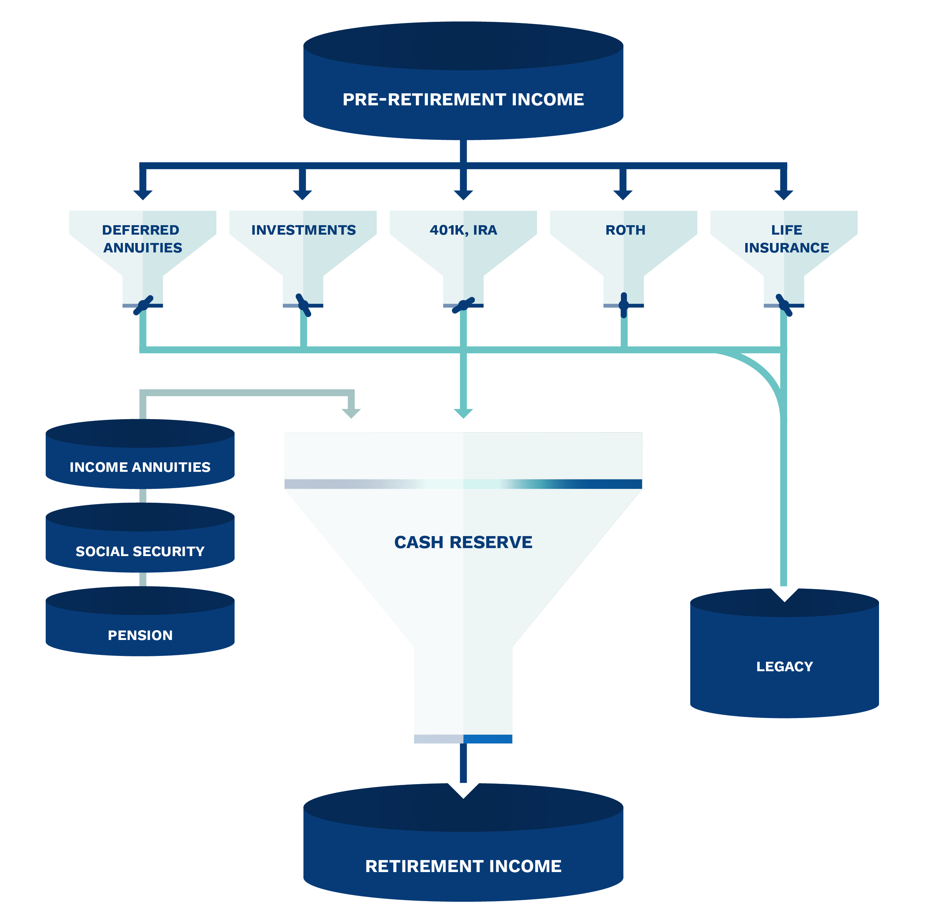

Slide 46
How wise is Conventional Wisdom?
Turns out, it’s not always good advice.
Conventional wisdom says to convert portfolio
Taxable Accounts
Tax Deferred Accounts
Tax Exempt Accounts (Roth)
Non-Deductible IRA
Non-Qualified Annuity
Notes:
How wise is Conventional Wisdom? Turns out, it’s not always good advice.
Conventional wisdom says to convert portfolio assets to retirement income in this order:
Taxable Accounts
Tax Deferred Accounts
Tax Exempt Accounts (Roth)
Non-Deductible IRA
Non-Qualified Annuity

Slide 47
Conventional Wisdom of Retirement Liquidations
Let the IRA Compound!
The classic approach:
after-tax “taxable” brokerage accounts should be liquidated first, while retirement accounts like IRAs and 401(k) plans receive preferential (tax-deferred) treatment and should be liquidated last.

Slide 48
Case Study
But is that really the best strategy for you?
Jim(66) and Joan(65) have saved a total of $679,000:
401(k) $500,000
Taxable $125,000
Roth $ 54,000
Plan to retire at age 67
They know they will need to spend conservatively, but they plan to enjoy retirement. Because they have multiple accounts that are taxed differently, they need advice on a withdrawal strategy to make their savings last as long as possible.
This hypothetical example is for illustrative purposes only, and should not be deemed a representation of past or future results, and is no guarantee of return or future performance.

Slide 49
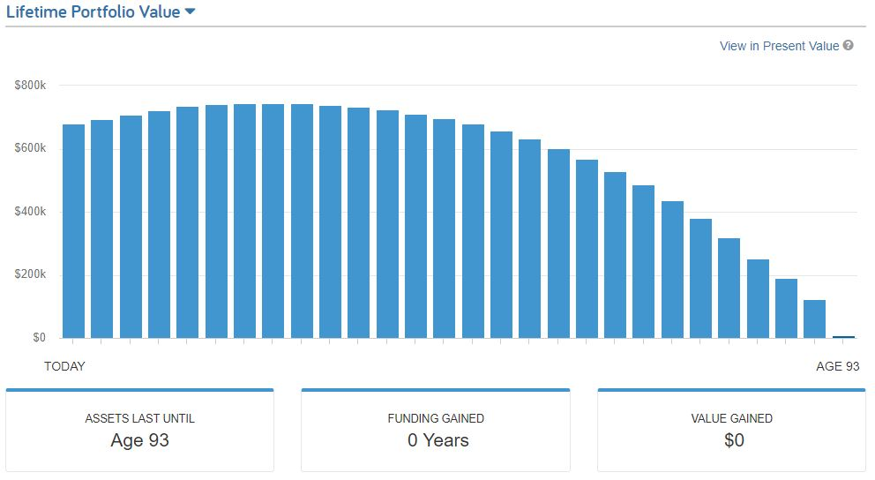
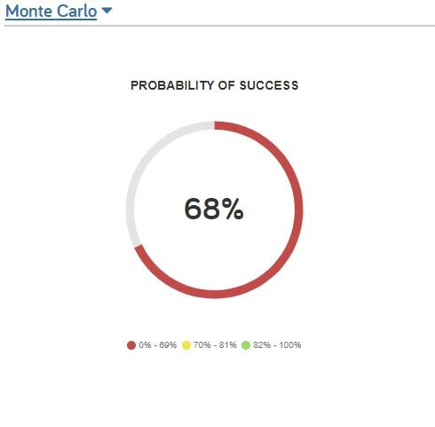
Scenario A
Conventional Wisdom
This hypothetical example is for illustrative purposes only, should not be deemed a representation of past or future results and is no guarantee of return or future performance. This example does not represent any specific product or service.
Notes:
What we've done here is we've used our Emoney software to determine how Jim and Joan will fair in retirement using conventional wisdom. Now, with conventional wisdom, they only have their needs and wants covered until age 93 and 92. That means they're going to run out of money before they run out of retirement. It will be only a few years before their only source of income is social security. In this example, we used an inflation rate of 3%, an annual rate of return of 6% and a withdrawal rate of a net of $30,000 per year.

Slide 50
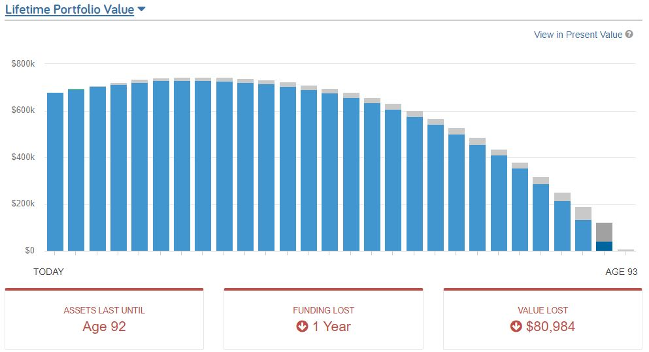
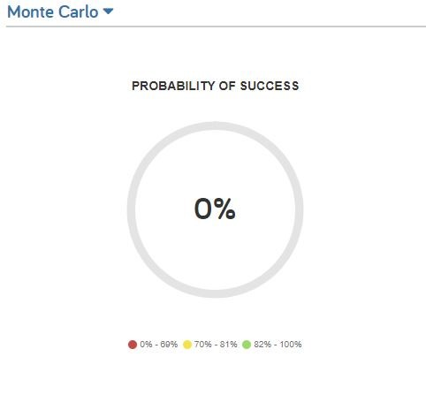
Scenario B
Unconventional Wisdom
This hypothetical example is for illustrative purposes only, should not be deemed a representation of past or future results and is no guarantee of return or future performance. This example does not represent any specific product or service.
Notes:
In this example, the unconventional wisdom, what we did is we flipped the returns, so instead of using the taxable accounts first, tax deferred accounts, and then Roth accounts, we went ahead and we did a spend down with using the Roth account first, the tax deferred account second, and then the taxable accounts third, so here's the difference for Jim and Joan - their level of coverage in the amount of their lifetime needs and wants that their assets will cover is now a little bit shorter. There still is a small gap between their assets and needs, simply changing the order they withdraw from their accounts, means that they have 1 less year of portfolio longevity. Now, in the conventional wisdom and unconventional wisdom, these previous two strategies, this is what we call sequential withdrawals.
In this example we kept everything the same, we used an inflation rate of 3.%, an annual rate of return of 6% and a withdrawal rate of a net of $30,000 per year.

Slide 51
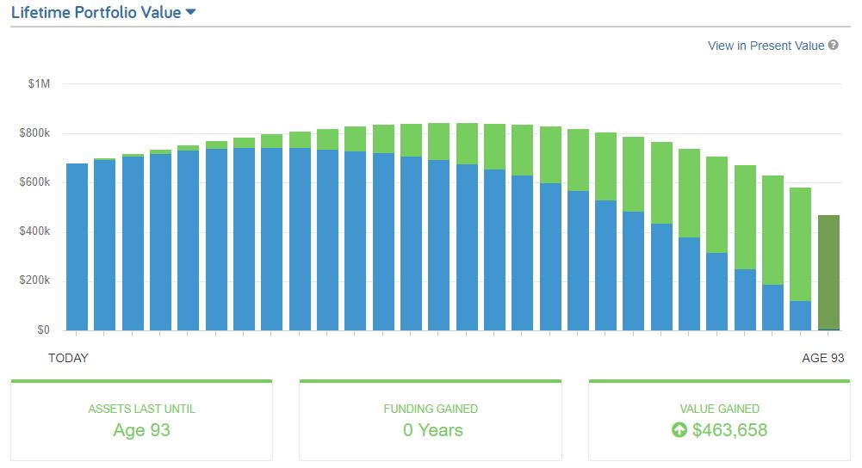
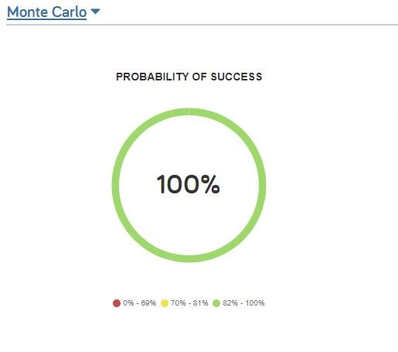
Scenario C
Multiple Accounts
This hypothetical example is for illustrative purposes only, should not be deemed a representation of past or future results and is no guarantee of return or future performance. This example does not represent any specific product or service.
Notes:
In this example, the unconventional wisdom, what we did is we used all accounts simultaneously rather than sequentially. Here's the difference for Jim and Joan - their level of coverage in the amount of their lifetime needs and wants that their assets will cover is now a little bit longer - it's age 101 to 100. There still is a small gap between their assets and needs, simply changing the how they withdraw from their accounts, means that they have 5 more years of portfolio longevity.
In this example we kept everything the same, we used an inflation rate of 3.%, an annual rate of return of 6% and a withdrawal rate of a net of $30,000 per year.

Slide 52
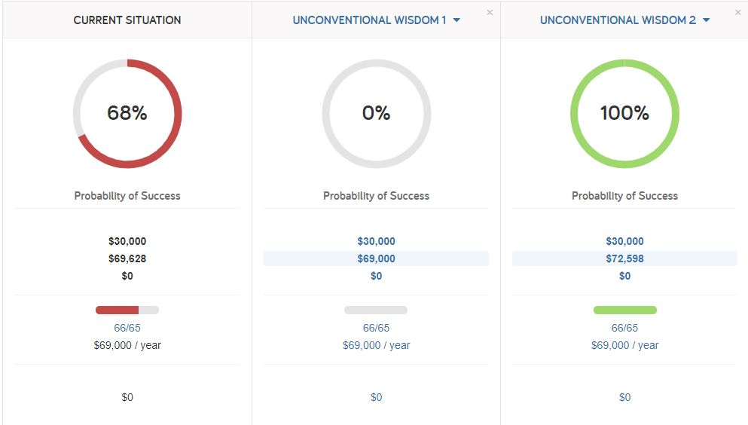
Scenario Comparison
This hypothetical example is for illustrative purposes only, should not be deemed a representation of past or future results and is no guarantee of return or future performance. This example does not represent any specific product and/or service.
Notes:
Lastly, let's look at a scenario comparison. Using sequential withdrawals, scenario A, is pulling from your taxable accounts and your tax-deferred and your tax-free accounts. Based on the results of our software and the assumptions used, the redline age that you run out of money is 93 and 92 and they're able to pull a total income of $1.1 million. Unconventional wisdom, when it comes to withdrawing your income, means that you're going to pull from your Roth first, your tax-deferred second, and your taxable accounts third. The redline age here is 96 or 95, and they have a total income of $1.6 million, but if you look at simultaneous withdrawals, scenario C, the redline age is now age 101 or 100 and they're able to pull out $2.1 million in withdrawals from the accounts. The key here is the withdrawal strategy that's created by simultaneously pulling income from various accounts to create the most efficient withdrawal strategy. From a tax perspective it is increasingly important the closer that you get to retirement to have a withdrawal strategy and a tax plan.

Slide 53
Income Plan
Legacy And Estate Plan
Investment Plan
Summary - Complete Planning
COMPLETE PLANNING
Healthcare Plan
Tax Plan
Notes:
SO what does all this mean for you?
First, we hope you understand better that when you claim SS matters! Sometimes it can be a matter of a month of waiting that will make a substantial difference in the lifetime benefits you receive.
The rules are complicated. They are voluminous. While you may be able to do some internet research and learn a few of the rules, the likelihood that you will overlook something important is significant. You need help with the rules, and we can provide that assistance.
There are many combinations of those rules that may help you. We use powerful software coded with all the rules to help you select a strategy that will get you the most in benefits – and we can help you compare other claiming options side-by-side.
Because your decision is irrevocable beyond 12 months, it’s critical that you get it right. You can’t afford to make a mistake.
Don’t delay – see us immediately
You need expert advice. Our firm can help remove the complexity and make it simpler for you.

Slide 54
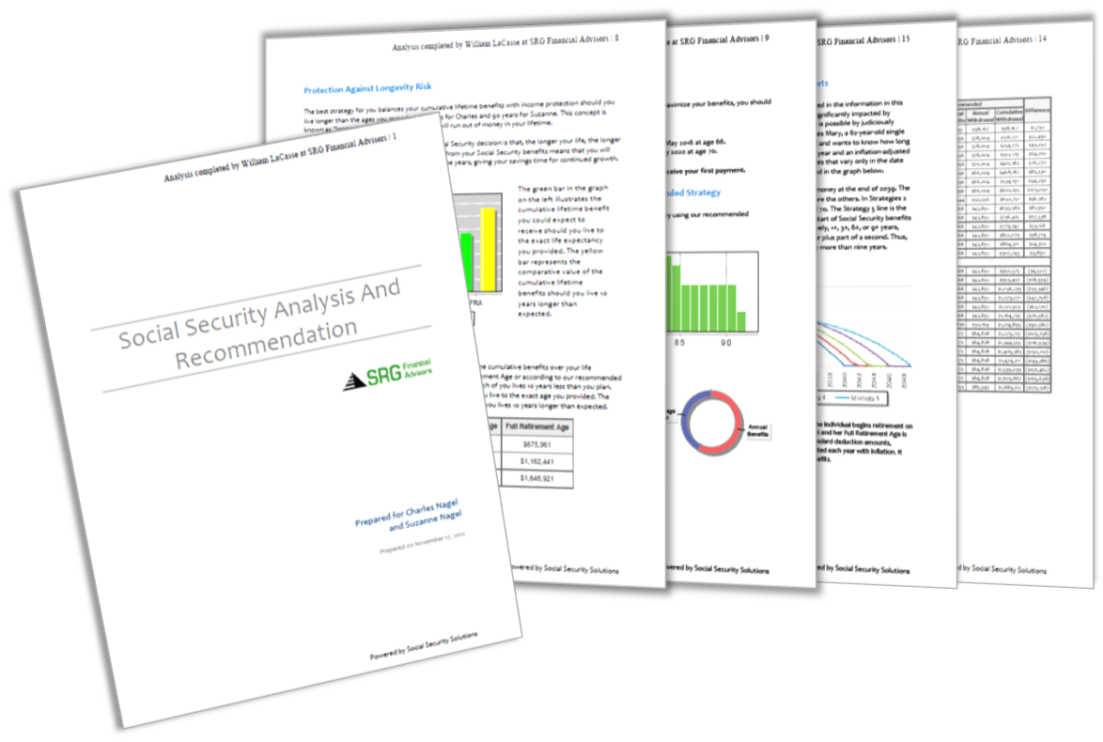
How we can help!
Complete Tax Plan Analysis
01
Tax Minimization Plan
Retirement Income Plan
IRA Distribution Plan
Withdrawal Strategy
IRA/RMD Strategy
Stretch IRA Strategy
Estate Tax Analysis
Portfolio Stress Test
02
ANSWERS!
03
04
05
06
07
08
Notes:
Insert you Call To Action here

Slide 55
Notes:
Insert your FORM here

